Slide 1
Baseline models

Slide 2
Different baseline models:
Copy past
Markovian
Non-markovian

Slide 3

Copy past
Quick and easy:
No learning needed
Just consider the system as static:
$$\vec{y_{t}}=\vec{y_{t−1}}$$

Slide 4

Markovian
Consider that all the information needed is in the last time point
Quick learning needed
$$\vec{y_{t}}=A\vec{x_{t−1}}$$

Slide 5

Non-Markovian
Consider that all the information needed is not in the last time point
Longer learning needed
$$\vec{y_{t}}=\sum_{Δ=1}^{Δ=m}{A_{Δ}\vec{x_{t−Δ}}}$$

Slide 6


Non-Markovian (In practice)
Each target is fit separately
To determine the value of delta:
Compute the cross-correlation of y with all the input variables
Set a threshold over this value (eg: 0.2 or 0.5) and a maximum window to remove the periodic characteristics
Set $x_{i}$ to 0 for all variables that do not reach the threshold
$$y_{i,t} =\sum_{Δ=1}^{Δ=m}{A_{iΔ}\vec{x_{t−Δ}}}$$

Slide 7
LSTM
Use a long-short term memory neural network with the following parameters:
2 Layers
0.3 dropout probability
0.01 l2-weight
Mean squared error loss
512 hidden dimensions
A 15 days context (with a new data each hour)
Time2Vec time encoding

Slide 8
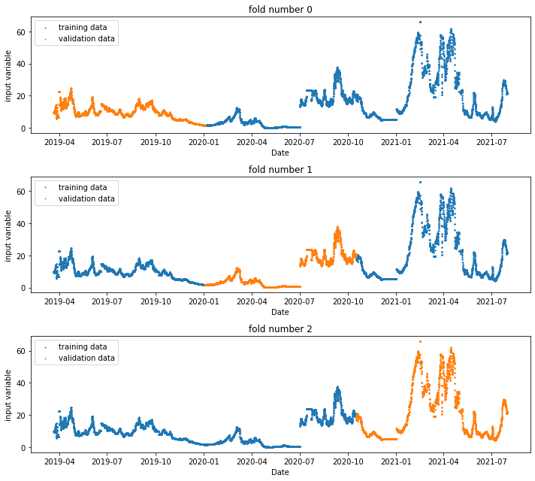
K-fold cross-validation
Example of 3-fold cross-validation

Slide 9
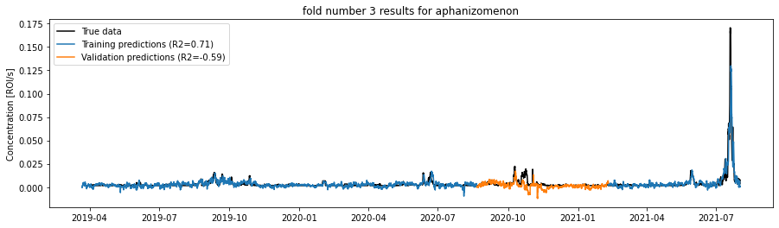
Why K-fold?
The training data is not representative of the behavior of the model on unseen events: The forecasting score always deteriorate

Slide 10
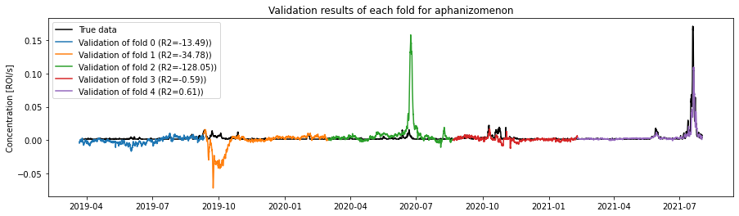
Why k-fold
Allows to use the whole dataset as validation once
Give a better statistical sense of model performance

Slide 11
About the plots
Intuitively, the similarity of the true data and prediction is seen as the shortest distance between the two curves
True data
Prediction
Intuitive error

Slide 12
About the plots
In forecasting however, only the vertical error is important
True data
Prediction
True error
Several published paper have used this trick without acknowledging it

Slide 13
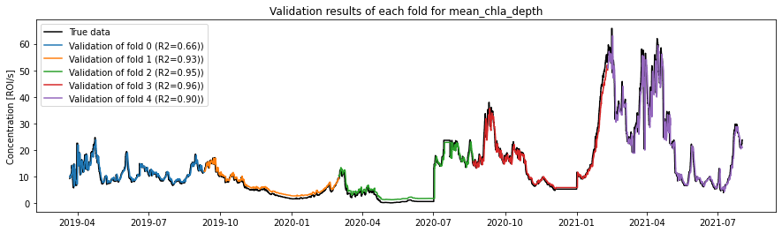
Example:
The fit in fold 0 (blue) is way worse than the one of fold 2 (green)

Slide 14

Add a Slide Title - 5

